Slide 1


Understanding College Majors
Analise Burko
& Marcos de la Torre

Slide 2
Imagine you are 17 again...
You are applying for college and must choose a major.
→ Would YOU rather have studied something else?
61% would change their undergraduate studies if they could go back
(https://www.bestcolleges.com/blog/college-graduate-majors-survey/)
- 38% would change for better job opportunities
- 23% would change for other reasons

Slide 3
Some data may help
In this presentation we provide some figures that may help understand the impact of the major choice, in terms of:
(qualified) employment
income

Slide 4

Behind the data...
Major
Major Category
IDENTIFIERS
Total Students
Men/
Women
DEMOGRAPHICS
American Community Survey
2010-2012
Median Income
Employed/ Unemployed
College-jobs/ non-college jobs
ECONOMICS
Low-wage
jobs
Full-time/Part-time

Slide 5

Major Categories
ENGINEERING
AERONAUTICAL
BIOMEDICAL
ELECTRICAL
MECHANICAL

Slide 6
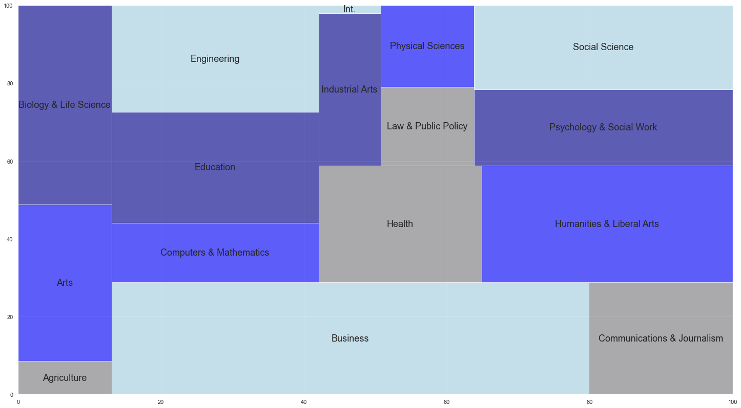
Category Popularity

Slide 7
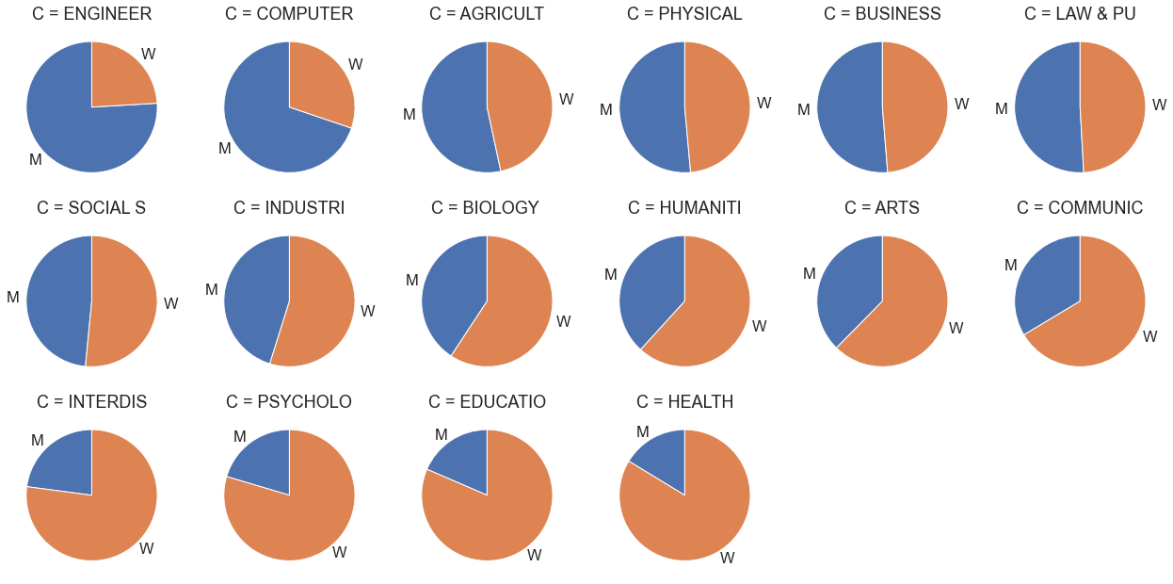
Popularity by Gender
Notes:
-address unbalanced categories, find culprit majors

Slide 8
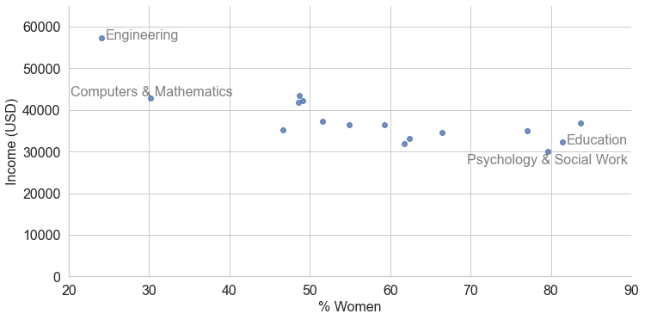
Income by rate of female student

Slide 9
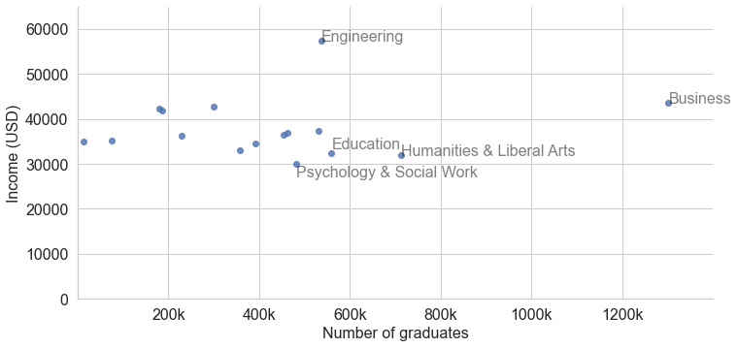
However,
Popularity ≠ Economic Success
There are plenty of areas that attract students but do not promise employability or high salaries

Slide 10
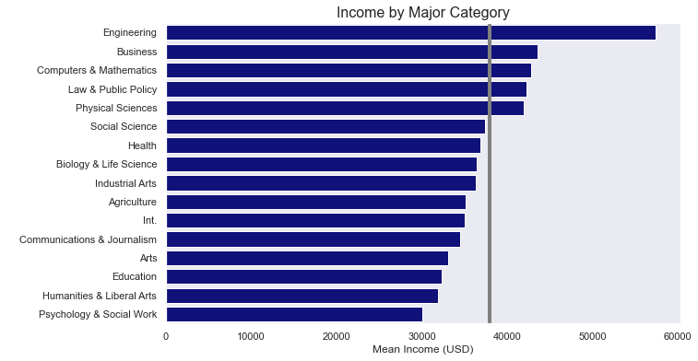
Income by Category

Slide 11
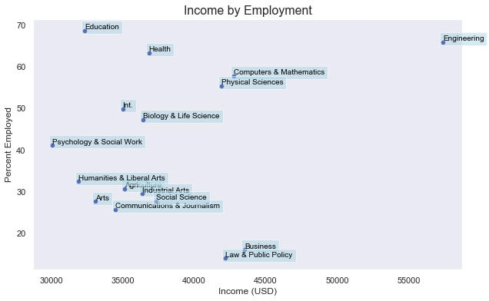
But we should also consider Employability!
LOW RISK
CAN'T BE BETTER
HIGH RISK!!
PROCEED WITH CAUTION

Slide 12

The story doesn't end there, there's always...
Graduate School

Slide 13
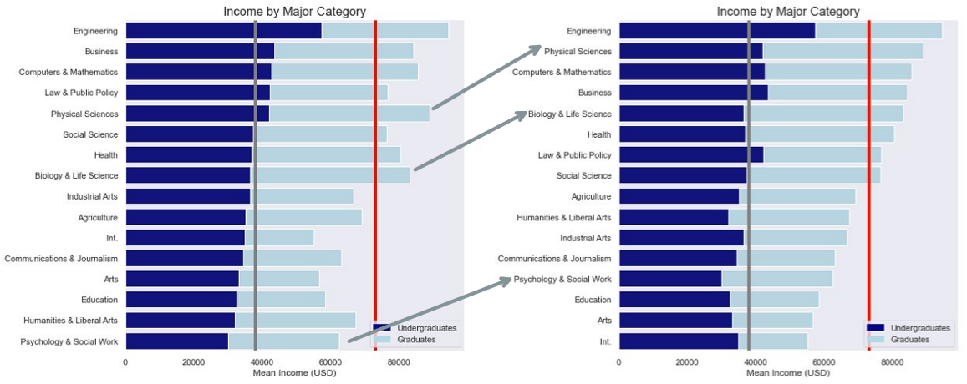
Economics

Slide 14
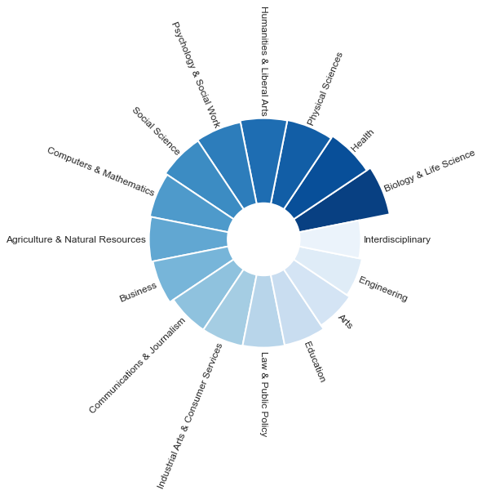
Percent income change
All major categories have a large percent increase in income
Categories with the GREATEST change
Biology & Life Sciences
Health
Physical Sciences
Categories with the LEAST change
Education
Arts
Engineering

Slide 15
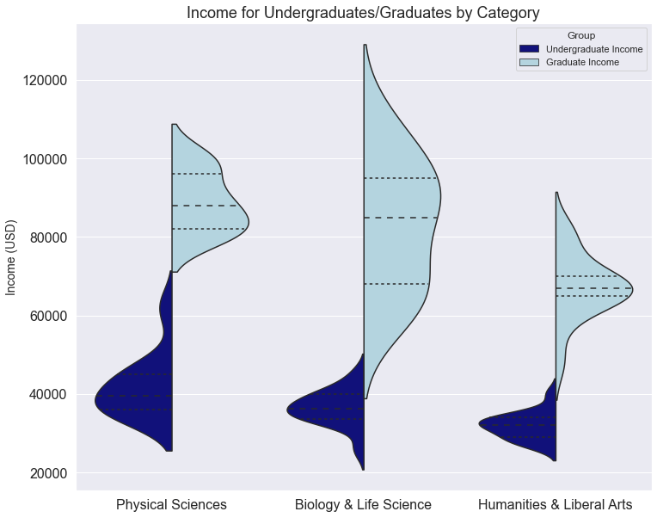
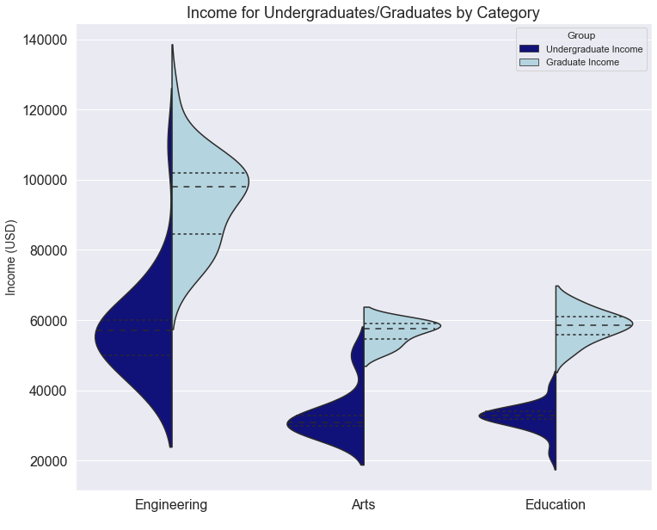
A Graduate degree increases income significantly...
Greatest Change
Least Change

Slide 16

LIMITATIONS
LOOKING FORWARD
our data is taken from recent graduates and post-graduates
Survey is from 2010-2012
Geographically constrained
Find more diverse data in terms of:
Long-term career progression
Demographics (age, gender, etc.)
Represented countries

Slide 17
Thank you!

